Slide 1
BCS350 – Web Database Development, Fall 2014
Week #12
File Uploads

Slide 2
Homework
Sometimes a webmaster needs to logon to a website as a user to diagnose a problem that the user is having. This is commonly called a "backdoor". The challenge is to come up with a solution to allow the webmaster to logon to a website as any valid user. The webmaster will know the USERID, but not the PASSWORD. You have to use the same LOGON program and you cannot modify the LOGON webpage in any way. You can only modify the LOGON program logic. If you provide a valid solution to this problem, your grade on the final exam will be bumped up one level, for example, B to B+. You can use the logon program from today's class, BCS350-logon.php, to implement and test your solution. The deadline is Nov. 18, the date of the next class, to send in your solutions to the CHALLENGE dropbox on Angel.

Slide 3
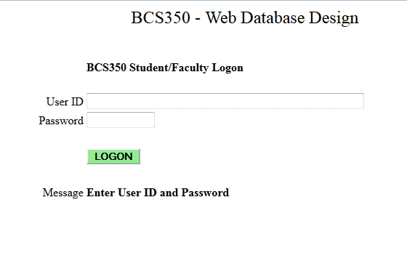
Homework

Slide 4
Homework
$allow_backdoor = TRUE;
$backdoor = "backdoor";
if ($msg == NULL) {
include('BCS350_mysql_connect.php');
$query = "SELECT firstname, lastname, role, password, status FROM roster WHERE userid='$userid'";
$result = $mysqli->query($query);
if (!$result) $msg = "Error accessing Roster Table " . mysql_error;
if ($result->num_rows > 0) {
list($firstname, $lastname, $role, $password, $status) = $result->fetch_row();
if (($pword == $password) OR (($allow_backdoor) AND ($pword == $backdoor)))
if ($status) {
$_SESSION['userid'] = $userid;
$_SESSION['role'] = $role;
$_SESSION['name'] = $name = "$firstname $lastname";
$logon = TRUE;
$location = "location: BCS350-Page2.php";
header($location);
exit();
}
}

Slide 5
Lab Preparation
Power on PC
Logon to BCS350, password is BCS#350
Download all files for Week 10 to c:/wamp/www
Start WAMPServer and NotePad++
Start PHPMyAdmin
Create a database called BCS350
Import roster.sql

Slide 6
Homework
Test the BACKDOOR password Logon Solution,
BCS350-logon.php
$allow_backdoor = TRUE;
$backdoor = "backdoor";
if (($pword == $password) OR (($allow_backdoor) AND
($pword == $backdoor)))

Slide 7
File Uploads with PHP

Slide 8
HTML 4 INPUT Types <input type=‘xxx’>
Value Description
button Defines a clickable button (mostly used with a JavaScript to activate a script)
checkbox Defines a checkbox
file Defines a file-select field and a "Browse..." button (for file uploads)
hidden Defines a hidden input field
image Defines an image as the submit button
password Defines a password field (characters are masked)
radio Defines a radio button
reset Defines a reset button (resets all form values to default values)
submit Defines a submit button
text Default. Defines a single-line text field (default width is 20 characters)

Slide 9
HTML 5 New INPUT Types
Value Description
color Defines a color picker
date Defines a date control (year, month and day (no time))
datetime Defines a date and time control (year, month, day, hour, minute, second, and fraction of a second, based on UTC time zone)
datetime-local Defines a date and time control (year, month, day, hour, minute, second, and fraction of a second (no time zone)
email Defines a field for an e-mail address
month Defines a month and year control (no time zone)
number Defines a field for entering a number
range Defines a control for entering a number whose exact value is not important (like a slider control)
search Defines a text field for entering a search string
tel Defines a field for entering a telephone number
time Defines a control for entering a time (no time zone)
url Defines a field for entering a URL
week Defines a week and year control (no time zone)

Slide 10
File Upload - HTML
File Upload<br><br>
<form action='$pgm' method='post'
enctype='multipart/form-data'>
Select File: <input type='file' name='pic'><br>
<input type='submit' name= 'upload'
value=‘Upload'><br>
<form>

Slide 11
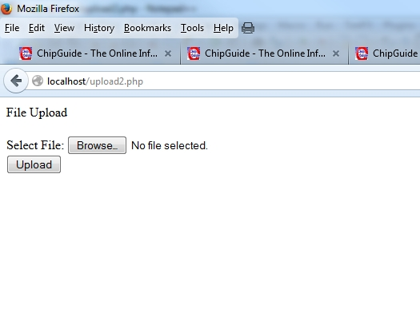
File Upload - HTML

Slide 12
PHP File Upload Using POST Method
Provides upload of both text and binary files. With PHP's authentication and file manipulation functions, you have full control over who is allowed to upload and what is to be done with the file once it has been uploaded.

Slide 13
File Upload – Process Flow
Temp
Dir
Page Request
Blank Form
Select File,
Press Submit
Webpage with Message
PHP
Valid Upload?
No
Yes
Perm
Dir
PHP
Move File to Directory

Slide 14
File Upload – PHP Process Flow
Temp
Dir
Page Request
Blank Form
Select File,
Press Submit
Webpage with Message
PHP
Valid Upload?
No
Yes
Perm
Dir
Update Table with FileName
PHP
Move File to Directory

Slide 15
How Does PHP Know About Uploaded Files?

Slide 16
PHP $_FILES Superglobal Variable
$_FILES is a two-dimensional associative array that contains file upload information
$_FILES[‘name’][‘element’]
1st dimension is connected to HTML “name=“ on the INPUT statement.
2nd dimension contains several elements related to the file upload.

Slide 17
$_FILES ELEMENTS
$_FILES['x']['name'] The original name of the file on the client machine.
$_FILES['x']['type'] The mime type of the file, if the browser provided this information. An example would be "image/gif". This mime type is however not checked on the PHP side and therefore don't take its value for granted.
$_FILES['x']['size'] The size, in bytes, of the uploaded file.
$_FILES['x']['tmp_name'] The temporary filename of the file in which the uploaded file was stored on the server.
$_FILES['x']['error'] The error code associated with this file upload.

Slide 18
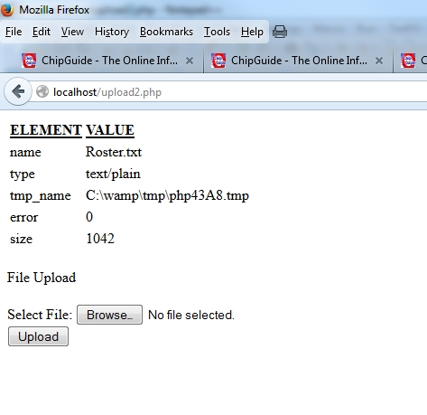
$_FILES ELEMENTS

Slide 19
File Upload Error Messages
PHP returns an appropriate error code along with the file array. The error code can be found in the error segment of the file array that is created during the file upload by PHP. In other words, the error might be found in $_FILES['userfile']['error'].
UPLOAD_ERR_OK Value: 0; There is no error, the file uploaded with success.
UPLOAD_ERR_INI_SIZE Value: 1; The uploaded file exceeds the upload_max_filesize directive in php.ini.
UPLOAD_ERR_FORM_SIZE Value: 2; The uploaded file exceeds the MAX_FILE_SIZE directive that was specified in the HTML form.
UPLOAD_ERR_PARTIAL Value: 3; The uploaded file was only partially uploaded.
UPLOAD_ERR_NO_FILE Value: 4; No file was uploaded.
UPLOAD_ERR_NO_TMP_DIR Value: 6; Missing a temporary folder. Introduced in PHP 5.0.3.
UPLOAD_ERR_CANT_WRITE Value: 7; Failed to write file to disk. Introduced in PHP 5.1.0.
UPLOAD_ERR_EXTENSION Value: 8; A PHP extension stopped the file upload. PHP does not provide a way to ascertain which extension caused the file upload to stop; examining the list of loaded extensions with phpinfo() may help. Introduced in PHP 5.2.0.

Slide 20
File Upload Strategy/Need
Write a general purpose file upload function that can be included and called in PHP scripts for all file uploads.

Slide 21
File Upload Function - Requirements
INPUTS
HTML INPUT name
Directory to store the uploaded file
Filename for uploaded file
Valid File extensions
Maximum File Size
OUTPUTS
Error Code: 0 (success), >0 (failure)
Filename (success), Error Message (failure)

Slide 22
File Upload Function - Design
Temp
Dir
Verify Input Parameters
Verify File Upload Data
Move File
New Filename
OK
OK
Failure
OK
Set Error Code, Message
Return Filename
User
Dir

Slide 23
Uploaded File Names
Uploaded files are placed in a directory
You cannot have two files with the same name in a directory
The MOVE_UPLOADED_FILE function will overwrite an existing file if a new file is uploaded with the same name
PHP scripts have to supply unique filenames for uploaded files
Solution: Uploaded files that are related to data in a table, use the ROWID of the data element and the original file extension, for example 1.jpg.

Slide 24
Review File Upload Function Code

Slide 25
Lab Preparation
Power on PC
Logon to BCS350, password is BCS#350
Download all files for Week 11 to c:/wamp/www
Start WAMPServer and NotePad++
Start PHPMyAdmin
Create a database called BCS350
Import roster.sql
Create Directory: c:/wamp/www/images

Slide 26
Lab Assignment
Write a PHP Script:
Display a File Upload Form
Include upload.php
Call upload.php
Displays results (Error Code, Message)
Valid file extensions for image (.jpg, .gif, .png)
If successful, display image

Slide 27
Lab Assignment
Review Sample Script

Slide 28
Lab Assignment #2
Modify Phone Book Update script (week 9) to allow image upload of contact’s picture and display image if available
Add picture column to phonebook table, varchar(20)
Picture filename is contact ROWID.ext
If not complete, do as Homework

Slide 29
Lab Preparation
Power on PC
Logon to BCS350, password is BCS#350
Download all files for Week 10 to c:/wamp/www
Start WAMPServer and NotePad++
Start PHPMyAdmin
Create a database called BCS350
Import phonebook.sql
Create Directory: c:/wamp/www/images

Slide 30
Homework
Complete modification of the Phone Book update script to allow upload of a contact’s image
Submit screen image to Angel Dropbox

Slide 31
Week 11 - Summary
File Uploads – provide ability for website users to add new content to a website or exchange of information
Care is needed to make sure that file uploads are within the requirements of the website
Week 12 – Website Design

